Slide 1
Containing the Madness
Getting started with docker

Slide 2
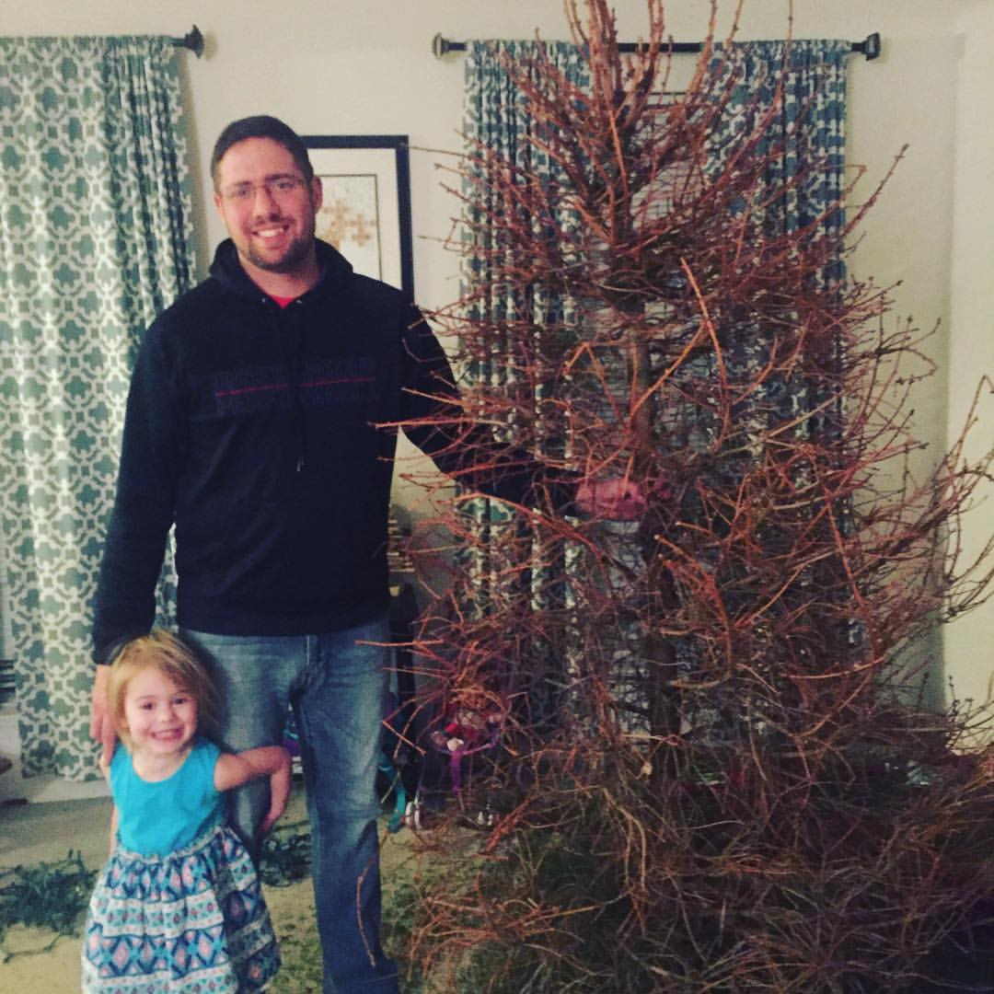

Jason L. van Brackel
Solutions Architect
@jasonvanbrackel
@k8sPhilly

Slide 3
A Brief History of Containers
Before Docker

Slide 4
A Brief History of Containers
Chaning the root directory of a process and all of its children to a new location in the filesystem
The beginning of process isolation
1979: Unix V7
chroot Introduced
A Brief History of Containers: From 1970s chroot to Docker 2016 - http://blog.aquasec.com/a-brief-history-of-containers-from-1970s-chroot-to-docker-2016

Slide 5
A Brief History of Containers
FreeBSD Jails allows administrators to partition a FreeBSD computer system into several independent, smaller systems – called “jails” – with the ability to assign an IP address for each system and configuration.
2000: FreeBSD
Jails
A Brief History of Containers: From 1970s chroot to Docker 2016 - http://blog.aquasec.com/a-brief-history-of-containers-from-1970s-chroot-to-docker-2016

Slide 6
A Brief History of Containers
FreeBSD Jails allows administrators to partition a FreeBSD computer system into several independent, smaller systems – called “jails” – with the ability to assign an IP address for each system and configuration.
2001: FreeBSD
Jails
A Brief History of Containers: From 1970s chroot to Docker 2016 - http://blog.aquasec.com/a-brief-history-of-containers-from-1970s-chroot-to-docker-2016

Slide 7
A Brief History of Containers
Linux VServer is a jail mechanism that can partition resources (file systems, network addresses, memory)
Introduced in 2001, this operating system virtualization that is implemented by patching the Linux kernel.
Experimental patches are still available, but the last stable patch was released in 2006
2001: Linux VServer
A Brief History of Containers: From 1970s chroot to Docker 2016 - http://blog.aquasec.com/a-brief-history-of-containers-from-1970s-chroot-to-docker-2016

Slide 8
A Brief History of Containers
Oracle released a Solaris Container that combines system resource controls and boundary separation provided by zones, which were able to leverage features like snapshots and cloning from ZFS.
The ZFS name originally stood for "Zettabyte File System
In 2005, the bulk of Solaris, including ZFS, was licensed as open-source software under the Common Development and Distribution License (CDDL), as the OpenSolaris project.
Became a standard feature in Solaris 10
2004: Oracle Solaris Containers
A Brief History of Containers: From 1970s chroot to Docker 2016 - http://blog.aquasec.com/a-brief-history-of-containers-from-1970s-chroot-to-docker-2016

Slide 9
A Brief History of Containers
This is an operating system-level virtualization technology for Linux which uses a patched Linux kernel for virtualization, isolation, resource management and checkpointing.
The code was not released as part of the official Linux kernel.
2005: OpenVZ (Open Virtuzzo)
A Brief History of Containers: From 1970s chroot to Docker 2016 - http://blog.aquasec.com/a-brief-history-of-containers-from-1970s-chroot-to-docker-2016

Slide 10
A Brief History of Containers
Google project designed to limit, account for and isolate resource usage
Later renamed to cgroups. Merged into the Linux kernel at 2.6.24 (24 Jan 2008)
2006: Process Containers
A Brief History of Containers: From 1970s chroot to Docker 2016 - http://blog.aquasec.com/a-brief-history-of-containers-from-1970s-chroot-to-docker-2016

Slide 11
A Brief History of Containers
LXC (LinuX Containers) was the first, most complete implementation of Linux container manager.
Implemented in 2008 using cgroups and Linux namespaces,
Linux kernel without requiring any patches.
2008: LXC
A Brief History of Containers: From 1970s chroot to Docker 2016 - http://blog.aquasec.com/a-brief-history-of-containers-from-1970s-chroot-to-docker-2016

Slide 12
A Brief History of Containers
Built by CloudFoundry
Their own version of LxC
Isolates environments on any operating system, running as a daemon and providing an API for container management.
Developed a client-server model to manage a collection of containers across multiple hosts
Includes a service to manage cgroups, namespaces and process life cycle.
2011: Warden
A Brief History of Containers: From 1970s chroot to Docker 2016 - http://blog.aquasec.com/a-brief-history-of-containers-from-1970s-chroot-to-docker-2016

Slide 13
A Brief History of Containers
Let Me Contain That For You (LMCTFY) Open-Source version of Google's container stack, providing Linux application containers.
Applications can be made “container aware,” creating and managing their own subcontainers.
Active deployment in LMCTFY stopped in 2015 after Google started contributing core LMCTFY concepts to libcontainer.
Which is now part of the Open Container Foundation.
2013: LMCTFY
A Brief History of Containers: From 1970s chroot to Docker 2016 - http://blog.aquasec.com/a-brief-history-of-containers-from-1970s-chroot-to-docker-2016

Slide 14
Virtualization and Container Concepts

Slide 15
Virtualization
Virtual Memory
Application Virtualization (JIT / JVM)
Hardware Virtualization (VMWare / Hyper-V)
Containers (OS Virtualization)

Slide 16
Containers – OS Virtualization
Local Disk looks like a pristine copy of the OS
Memory appears consistent with a freshly booted OS

Slide 17
Containers are not VMs
VM
Containers
App A
App A₁
App B
Windows Server Guest OS
Windows Server Guest OS
Windows Server Guest OS
App A
App A₁
App A₂
App A₃
App B
App B₁
Docker
Hypervisor (Type 2)
Windows Server (Host OS)
Windows Server (Host OS)
Server
Server

Slide 18
Containers are not VMs
VM
Containers
App A
App A₁
App B
Windows Server Guest OS
Windows Server Guest OS
Windows Server Guest OS
App A
App A₁
App A₂
App A₃
App B
App B₁
Docker
Hypervisor (Type 1)
Windows Server (Host OS)
Server
Server

Slide 19
Containers are not VMs
VM
Containers
App A
App A₁
App B
App A
App A₁
App A₂
App A₃
App B
App B₁
Docker
App A
App A₁
App A₂
App A₃
App B
App B₁
Docker
App A
App A₁
App A₂
App A₃
App B
App B₁
Docker
Windows Server Guest OS
Windows Server Guest OS
Windows Server Guest OS
Windows Server (Host OS)
Windows Server (Host OS)
Windows Server (Host OS)
Hypervisor (Type 1)
Hypervisor (Type 1)
Server
Server

Slide 20
Containers are not VMs
VMs
Containers
Hardware Virtualization
OS Isolation
Full Copy of the OS
Hypervisor responsible for maintaining isolation
OS Virtualization
Userspace and Namespace Isolation
Enough of the OS for the Application to use
Docker Daemon responsible for maintaining isolation

Slide 21
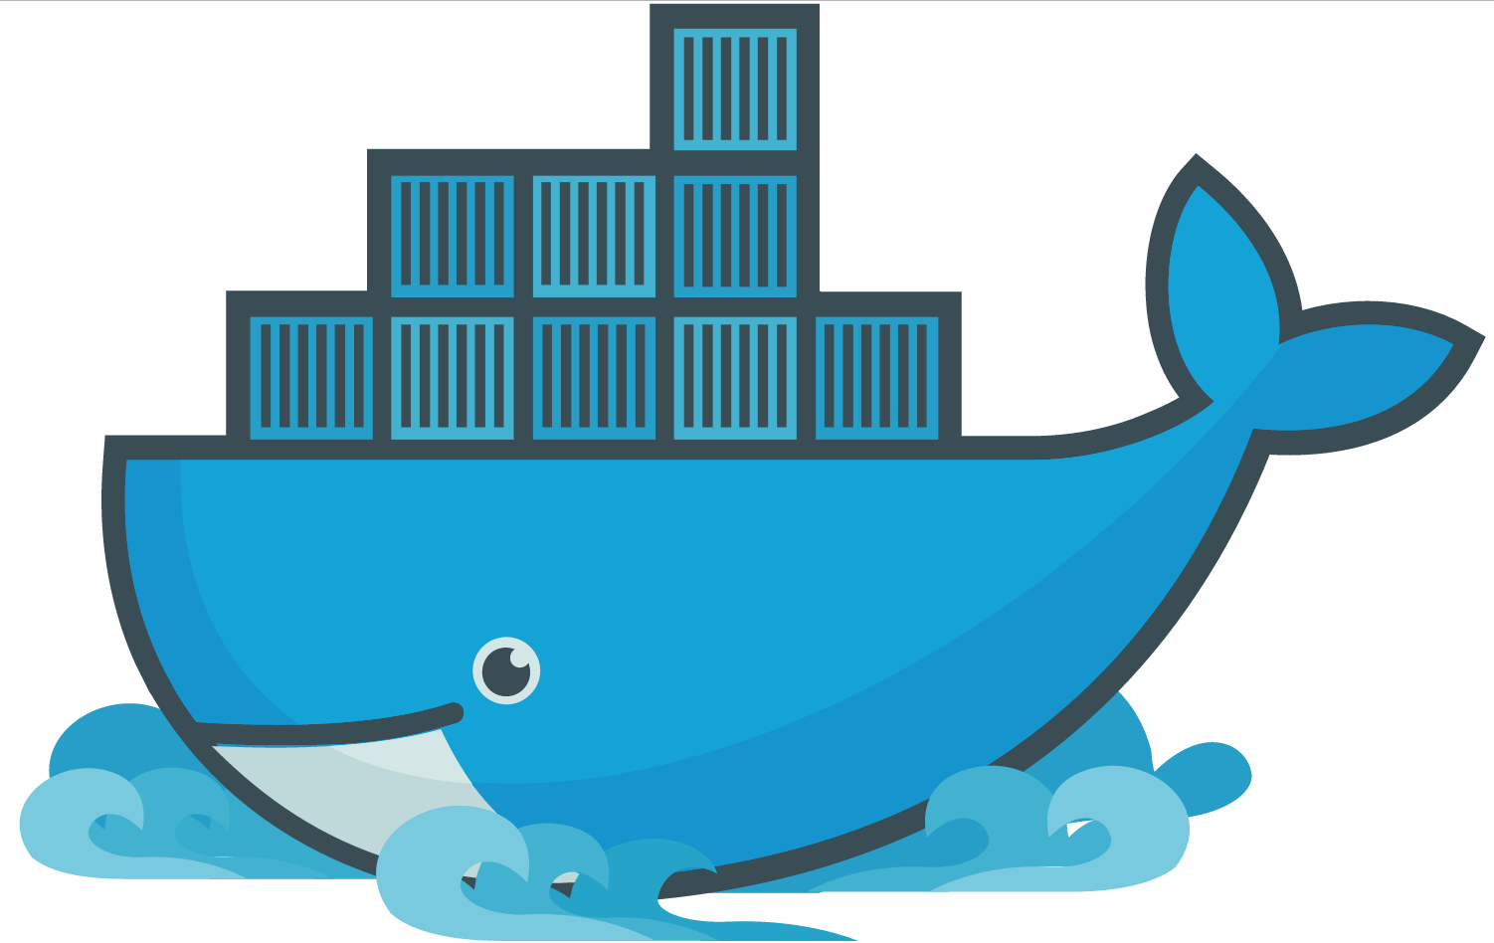
Docker

Slide 22
Docker
A company
A suite of tools for building, deploying and managing applications using Docker containers
An container engine

Slide 23
Docker Engine
It runs docker images
docker
dockerd

Slide 24
Docker Toolbox
A virtualized development environment to create docker images in Windows and Mac OSX
Backed by VirtualBox
Conflicts with Hyper-V
Conflicts with Docker for Windows

Slide 25
Docker Machine
Install and run Docker on Mac or Windows
Provision and manage multiple remote Docker hosts
Provision Swarm clusters

Slide 26
Docker Compose
Tool for defining and running multi-container Docker applications
Define your app’s environment with a Dockerfile
Define services that make up your app in docker-compose.yml
Run

Slide 27
Docker Swarm
Prior to version 1.12
Docker Swarm is native clustering for Docker
Turns a pool of Docker hosts into a single, virtual Docker host
Uses the standard Docker API, any tool that already communicates with a Docker daemon can use Swarm to transparently scale to multiple hosts
Functionality folded into Docker in 1.12
Swarm mode

Slide 28
Docker Container Fundamentals

Slide 29
Docker Container Fundamentals
dockerd
thin layer between containers and the kernel
Docker Daemon

Slide 30
Docker Container Fundamentals
Developer user dockerfiles to build container images
Dockerfile

Slide 31
Dockerfile
FROM microsoft/iis
RUN mkdir C:\site
RUN powershell -NoProfile -Command \
Import-module IISAdministration; \
New-IISSite -Name "Site" -PhysicalPath C:\site -BindingInformation "*:8000:“
ADD content/ /site

Slide 32
# Pull base image.
FROM dockerfile/ubuntu
# Install Nginx.
RUN \
add-apt-repository -y ppa:nginx/stable && \
apt-get update && \
apt-get install -y nginx && \
rm -rf /var/lib/apt/lists/* && \
echo "\ndaemon off;" >> /etc/nginx/nginx.conf && \
chown -R www-data:www-data /var/lib/nginx
# Define mountable directories.
VOLUME ["/etc/nginx/sites-enabled", "/etc/nginx/certs", "/etc/nginx/conf.d", "/var/log/nginx", "/var/www/html"]
# Define working directory.
WORKDIR /etc/nginx
# Define default command.
CMD ["nginx"]
# Expose ports.
EXPOSE 80
EXPOSE 443

Slide 33
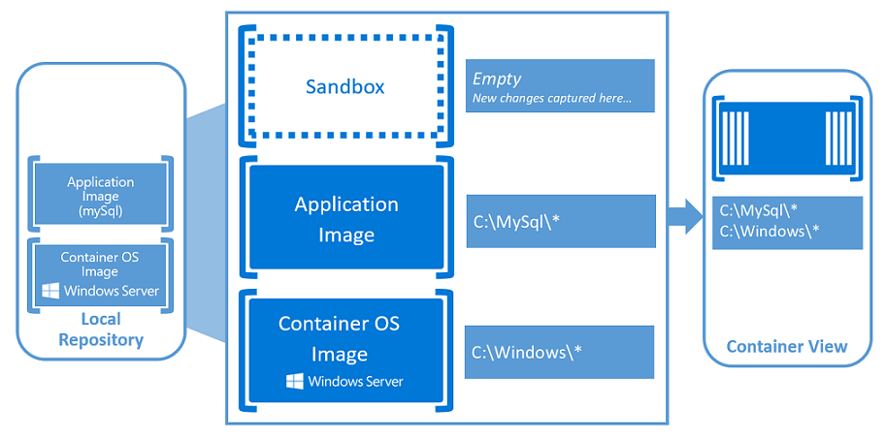
Container Fundamentals
Windows Containers - https://docs.microsoft.com/en-us/virtualization/windowscontainers/about/index

Slide 34
Docker Container Fundamentals
Container Images are Published and Stored here
Docker Hub is a public cloud-based container registry managed by Docker
Registry

Slide 35
Docker Architecture

Slide 36
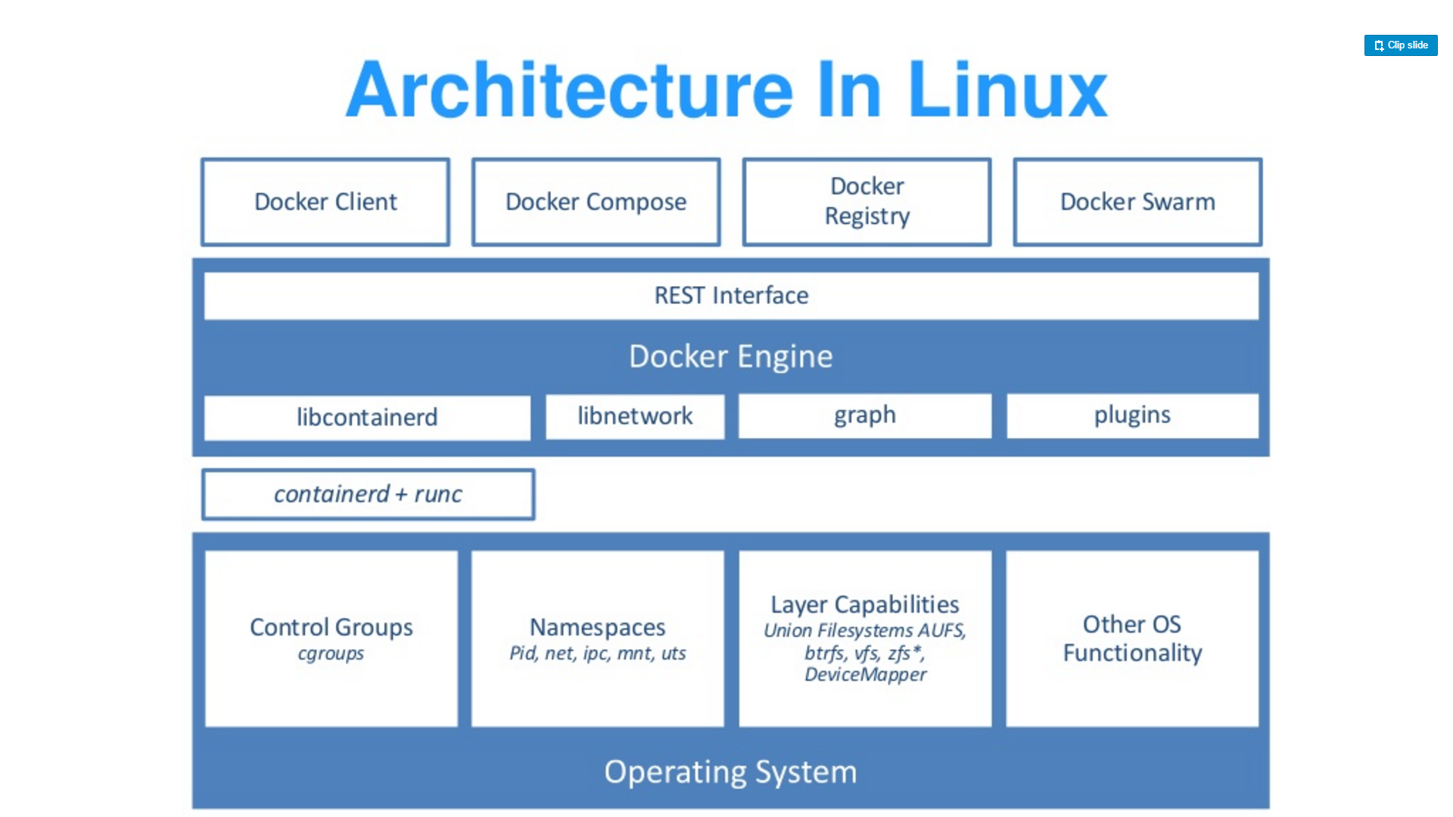
Source: “DockerCon 16: Windows Server & Docker - The Internals Behind Bringing Docker & Containers to Windows - Black Belt”

Slide 37
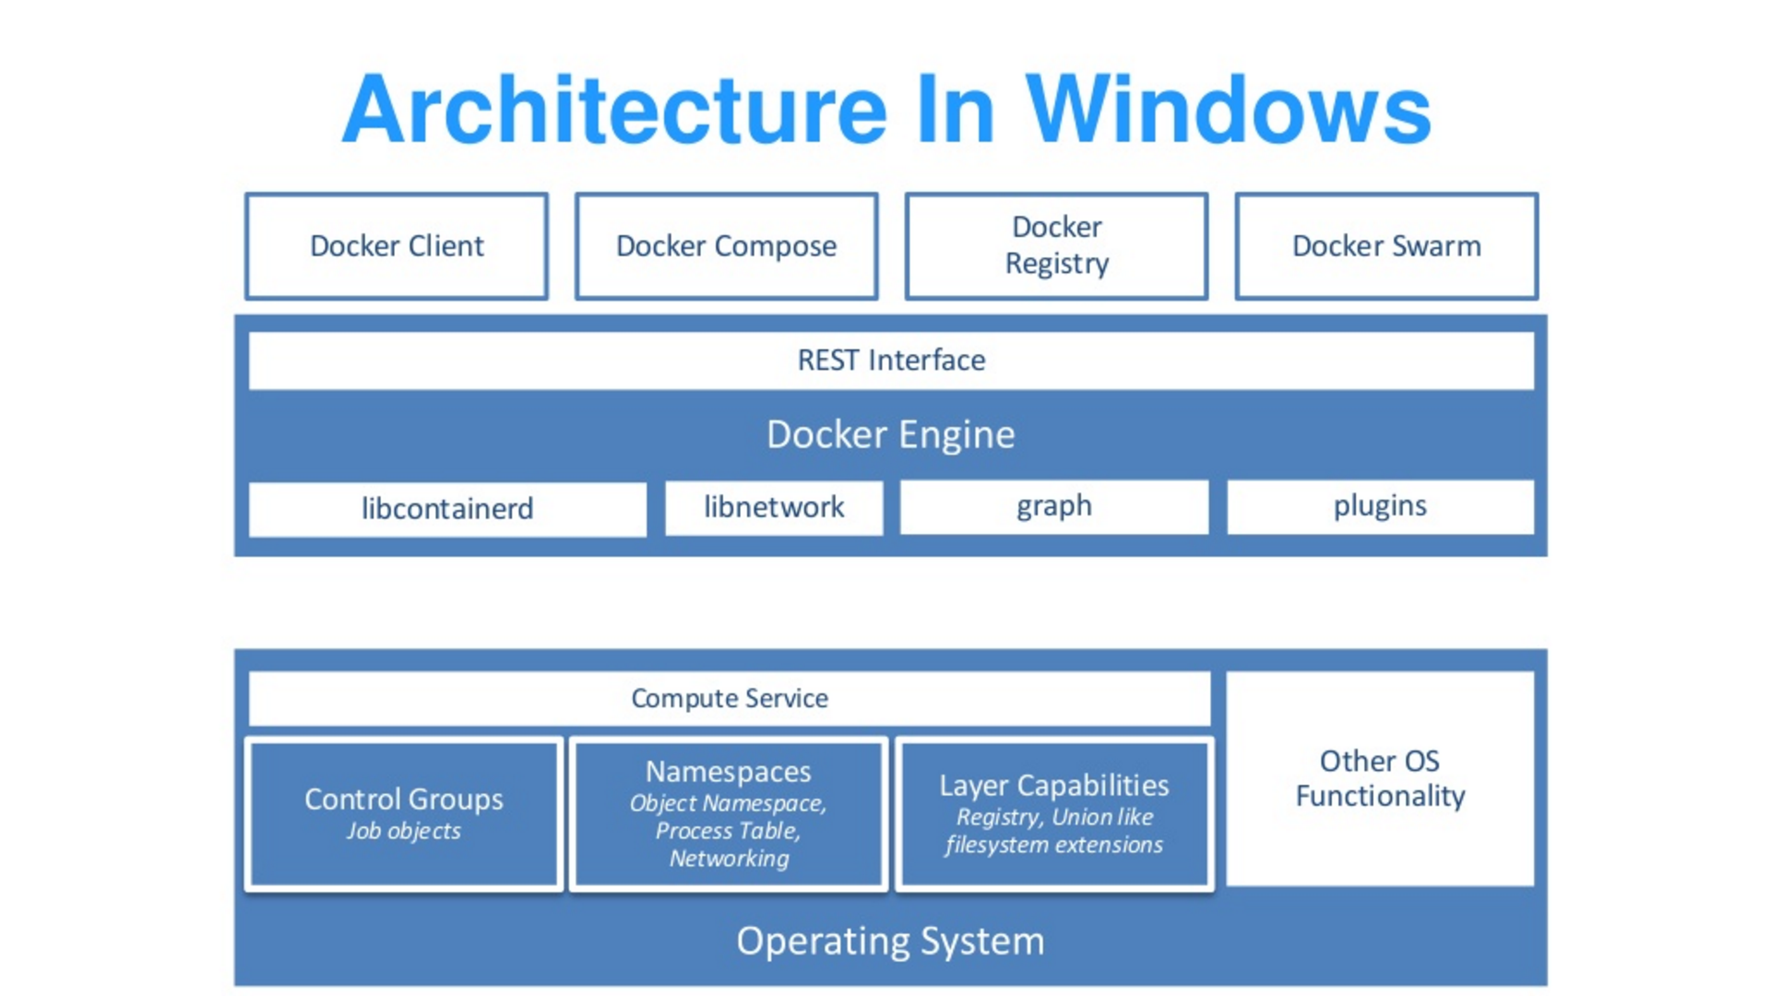
Source: “DockerCon 16: Windows Server & Docker - The Internals Behind Bringing Docker & Containers to Windows - Black Belt”

Slide 38
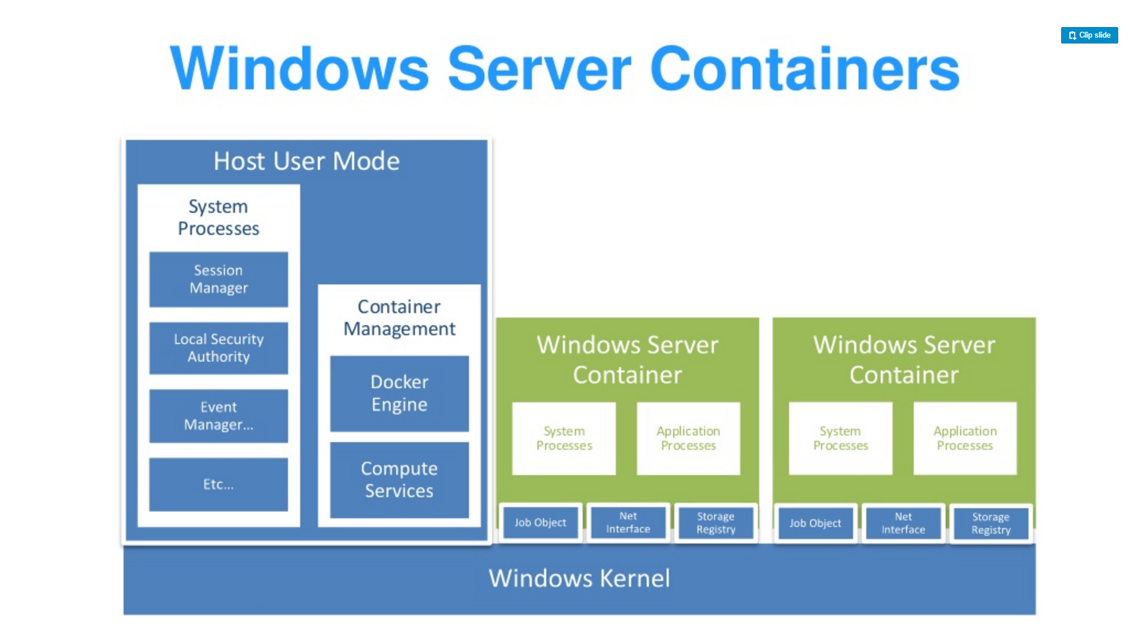
Source: “DockerCon 16: Windows Server & Docker - The Internals Behind Bringing Docker & Containers to Windows - Black Belt”

Slide 39
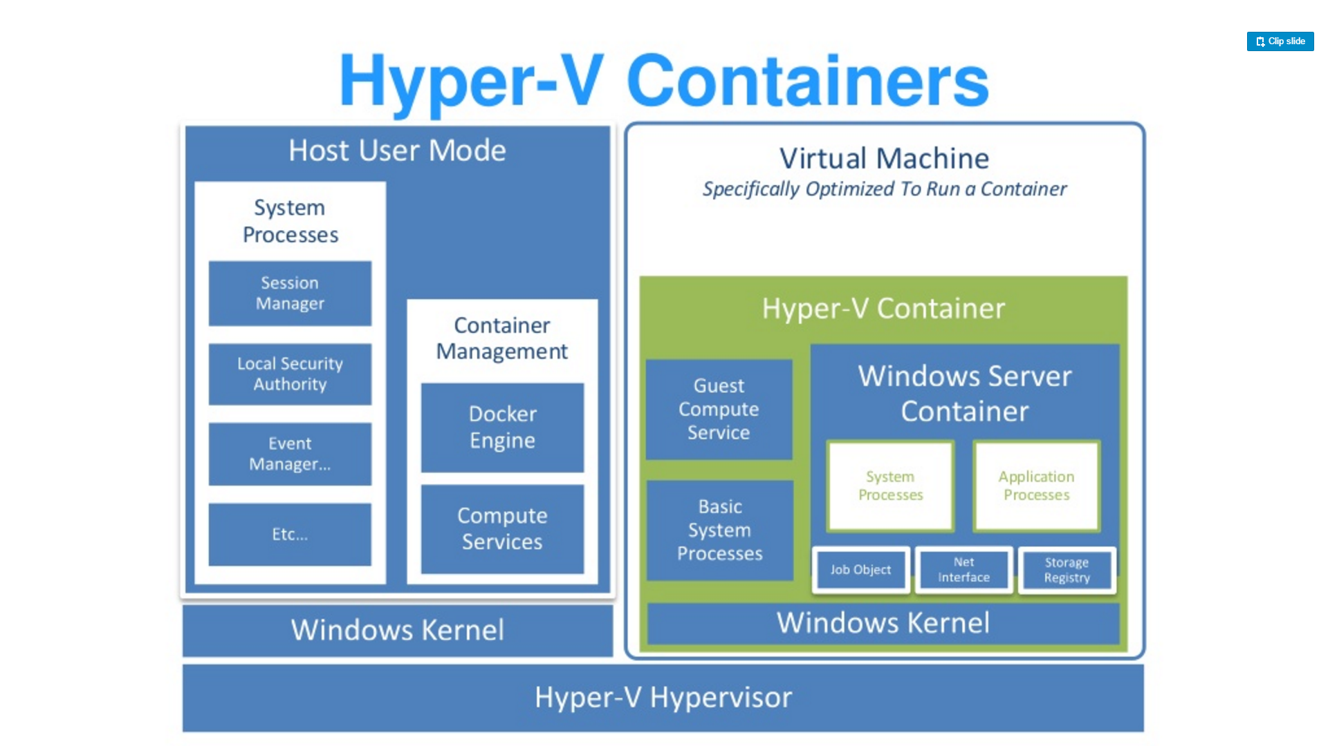
Source: “DockerCon 16: Windows Server & Docker - The Internals Behind Bringing Docker & Containers to Windows - Black Belt”

Slide 40
Container Types
Default in Windows 10
Small, stateless VM
Writes are not persisted
Storage attached via SMB
Over VMBus not networking
Physically map executables from the host file cache
Networking is a virtual nic
Cloning
Launch utility VM
Freeze State
Fork the VM for each new instance
No startup time
Shares memory
Hyper-V Container
Source: https://en.wikipedia.org/wiki/UnionFS

Slide 41
More Information on Architecture
DockerCon 16: Windows Server & Docker - The Internals Behind Bringing Docker & Containers to Windows - Black Belt
https://channel9.msdn.com/Blogs/containers/DockerCon-16-Windows-Server-Docker-The-Internals-Behind-Bringing-Docker-Containers-to-Windows

Slide 42
Dockerfile and Docker Compose

Slide 43
Dockerfile
FROM microsoft/iis
RUN mkdir C:\site
RUN powershell -NoProfile -Command \
Import-module IISAdministration; \
New-IISSite -Name "Site" -PhysicalPath C:\site -BindingInformation "*:8000:“
ADD content/ /site

Slide 44
Dockerfile
Containers should be ephemeral
Consistent with Processes section of 12 factor application methodology
General guildelines

Slide 45
Dockerfile
Avoid installing unnecessary packages
Reduces complexity
Reduces dependencies
Reduces files sizes
Reduces build times
General guildelines

Slide 46
Dockerfile
Each container should do 1 thing
Containers that depend on one another should be networked
Not one process per container
General guildelines

Slide 47
Dockerfile
Sort multi-line arguments
Easier to read and maintain
RUN apt-get update && apt-get install -y \
bzr \
cvs \
git \
mercurial \
subversion
General guildelines

Slide 48
Dockerfile instructions
FROM
Sets the base image
FROM <image>
FROM <image>:<tag>
FROM

Slide 49
Dockerfile instructions
RUN
Executes the command on the current image and commits the results
RUN <command>
/bin/sh –c
cmd /S /C
RUN [“executable”, “param1”, “param2”]
RUN

Slide 50
Dockerfile instructions
https://github.com/docker/compose/releases/download/1.11.1/
CMD
There can be only one per Dockerfile
The main purpose is to provide defaults for an executing container.
CMD ["executable","param1","param2"]
CMD

Slide 51
Dockerfile instructions
EXPOSE
Informs the Docker engine that the container listens to this port at run time.
EXPOSE <port> [<port>...]
EXPOSE

Slide 52
Dockerfile instructions
ENV
Sets an environment variable in the container
ENV key value ENV key=value
ENV

Slide 53
Dockerfile instructions
ADD
Copies files from the developer’s system to the container’s file system.
ADD <src>... <dest>
ADD ["<src>",... "<dest>"] (this form is required for paths containing whitespace)
ADD

Slide 54
Dockerfile instructions
COPY
Copies files from the developer’s system to the container’s file system.
COPY <src>... <dest>
COPY ["<src>",... "<dest>"] (this form is required for paths containing whitespace)
COPY

Slide 55
Dockerfile instructions
ENTRYPOINT
An ENTRYPOINT allows you to configure a container that will run as an executable
FROM ubuntu
ENTRYPOINT ["top", "-b"]
CMD ["-c"]
FROM debian:stable
RUN apt-get update && apt-get install -y --force-yes apache2
EXPOSE 80 443
VOLUME ["/var/www", "/var/log/apache2", "/etc/apache2"]
ENTRYPOINT ["/usr/sbin/apache2ctl", "-D", "FOREGROUND"]
ENTRYPOINT

Slide 56
Dockerfile instructions
VOLUME
The VOLUME instruction creates a mount point with the specified name and marks it as holding externally mounted volumes from native host or other containers.
FROM ubuntu
RUN mkdir /myvol
RUN echo "hello world" > /myvol/greeting
VOLUME /myvol
docker run -v /Users/<path>:/<container path> docker run -v //c/<path>:/<container path>
VOLUME

Slide 57
Dockerfile instructions
USER
The USER instruction sets the user name or UID to use when running the image and for any RUN, CMD and ENTRYPOINT instructions that follow it in the Dockerfile.
USER

Slide 58
Dockerfile instructions
WORKDIR
The WORKDIR instruction sets the working directory for any RUN, CMD, ENTRYPOINT, COPY and ADD instructions that follow it in the Dockerfile. If the WORKDIR doesn’t exist, it will be created even if it’s not used in any subsequent Dockerfile instruction.
WORKDIR /a
WORKDIR b
WORKDIR c
RUN pwd
WORKDIR

Slide 59
Dockerfile instructions
ARG
The ARG instruction defines a variable that users can pass at build-time to the builder with the docker build command using the --build-arg <varname>=<value>
ARG <name>[=<default value>]
ARG

Slide 60
Dockerfile instructions
ONBUILD
The ONBUILD instruction adds to the image a trigger instruction to be executed at a later time, when the image is used as the base for another build. The trigger will be executed in the context of the downstream build, as if it had been inserted immediately after the FROM instruction in the downstream Dockerfile.
ONBUILD [INSTRUCTION]
ONBUILD

Slide 61
Dockerfile instructions
HEALTHCHECK
The HEALTHCHECK instruction tells Docker how to test a container to check that it is still working.
New as of Docker 1.12
HEALTHCHECK --interval=5m --timeout=3s \
CMD curl -f http://localhost/ || exit 1
HEALTHCHECK

Slide 62
Dockerfile instructions
SHELL
The SHELL instruction allows the default shell used for the shell form of commands to be overridden. The default shell on Linux is ["/bin/sh", "-c"], and on Windows is ["cmd", "/S", "/C"].
SHELL ["powershell", "-command"]
RUN Write-Host hello
SHELL

Slide 63
Dockerfile examples

Slide 64
# Nginx
#
# VERSION 0.0.1
FROM ubuntu
LABEL Description="This image is used to start the foobar executable" Vendor="ACME Products" Version="1.0"
RUN apt-get update && apt-get install -y inotify-tools nginx apache2 openssh-server

Slide 65
# Firefox over VNC
#
# VERSION 0.3
FROM ubuntu
# Install vnc, xvfb in order to create a 'fake' display and firefox
RUN apt-get update && apt-get install -y x11vnc xvfb firefox
RUN mkdir ~/.vnc
# Setup a password
RUN x11vnc -storepasswd 1234 ~/.vnc/passwd
# Autostart firefox (might not be the best way, but it does the trick)
RUN bash -c 'echo "firefox" >> /.bashrc'
EXPOSE 5900
CMD ["x11vnc", "-forever", "-usepw", "-create"]

Slide 66
# Firefox over VNC
#
# VERSION 0.3
FROM ubuntu
# Install vnc, xvfb in order to create a 'fake' display and firefox
RUN apt-get update && apt-get install -y x11vnc xvfb firefox
RUN mkdir ~/.vnc
# Setup a password
RUN x11vnc -storepasswd 1234 ~/.vnc/passwd
# Autostart firefox (might not be the best way, but it does the trick)
RUN bash -c 'echo "firefox" >> /.bashrc'
EXPOSE 5900
CMD ["x11vnc", "-forever", "-usepw", "-create"]

Slide 67
# MongoDB
FROM microsoft/windowsservercore
ENV MONGO_VERSION=3.4.1
COPY build /
RUN mkdir C:\data\db & setx /m PATH %PATH%;C:\mongodb\bin
VOLUME C:\\data\\db
EXPOSE 27017
CMD ["mongod.exe"]

Slide 68
#NodeJS
FROM microsoft/windowsservercore
SHELL ["powershell", "-Command", "$ErrorActionPreference = 'Stop'; $ProgressPreference = 'SilentlyContinue';"]
ENV NPM_CONFIG_LOGLEVEL info
ENV NODE_VERSION 7.6.0
ENV NODE_SHA256 9cc8fd129483aa64557155842dc8f1e7ed288efeab1a7fbb0210314bc7213058
RUN Invoke-WebRequest $('https://nodejs.org/dist/v{0}/node-v{0}-win-x64.zip' -f $env:NODE_VERSION) -OutFile 'node.zip' -UseBasicParsing ; \
if ((Get-FileHash node.zip -Algorithm sha256).Hash -ne $env:NODE_SHA256) {exit 1} ; \
Expand-Archive node.zip -DestinationPath C:\ ; \
Rename-Item -Path $('C:\node-v{0}-win-x64' -f $env:NODE_VERSION) -NewName 'C:\nodejs' ; \
New-Item $($env:APPDATA + '\npm') ; \
$env:PATH = 'C:\nodejs;{0}\npm;{1}' -f $env:APPDATA, $env:PATH ; \
[Environment]::SetEnvironmentVariable('PATH', $env:PATH, [EnvironmentVariableTarget]::Machine) ; \
Remove-Item -Path node.zip
CMD [ "node.exe" ]

Slide 69
Docker Compose
Tool for defining and running multi-container Docker applications
Define your app’s environment with a Dockerfile
Define services that make up your app in docker-compose.yml
Run

Slide 70
Docker Compose
The Compose file is a YAML file defining services, networks and volumes
Default path is ./docker-compose.yaml

